Slide 1
Iot training 2025 cohort 5 group 2 team 2
Presented by
Juan Jimenez
Magnus Eriksson
Vitor Medeiros
Yuvrajsinh Adajania

Slide 2




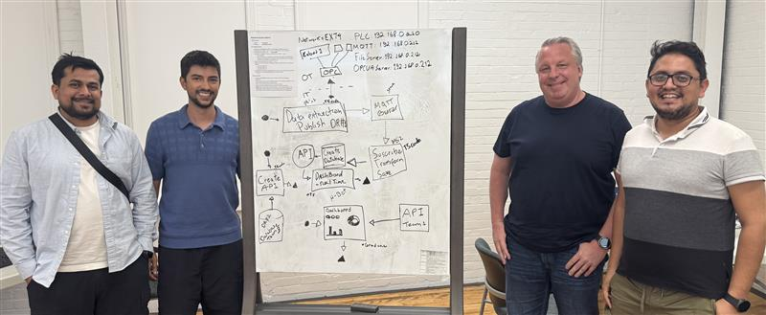
OUR TEAM
Juan Jimenez – IoT developer – Magna
Magnus Eriksson - Developer
Vitor Medeiros – Local divisional IT
Yuvrajsinh Adajania – Controls engineer

Slide 3
Project deliverables
Develop a Visual Representation Create a visual interface that displays the H-Bot robot's end-effector position over a graphical layout of the conveyor system.
Design an API using Team 3's Database Build a functional API that enables access and interaction with the data stored in Team 3’s database.
Implement a Visual Interface Using Team 1’s API Utilize the API developed by Team 1 to generate a dynamic visual representation of relevant system components or data.

Slide 4
Tools and technologies
💻 Development & Coding
Visual Studio Code – Main code editor
TypeScript – Language used for building services
HTML – Used to create the dashboard interface
🗃️ Data Management
pgAdmin – PostgreSQL database management and querying
Docker – Containerization for services and database deployment
📂 Version Control
GitHub – Code collaboration, version control, and repository hosting
📡 Communication & Integration​
OPC UA Server – Interface for robot data communication​
MQTT Broker – Lightweight messaging protocol for data transfer​
MQTT Explorer – Tool for visualizing MQTT topics and payloads
📊 Visualization & Dashboard
Grafana – Real-time data visualization and dashboard
Custom HTML Dashboard – Custom display for robot data
📋 Project Management
Jira – Task tracking and sprint planning
Confluence – Documentation and team collaboration

Slide 5





DEVELOP A VISUAL REPRESENTATION
SYSTEM ARCHITECTURE
OPC SERVER
MS1 - Publisher
MQTT Broker
MS2 - Ingestion
Database
Robot_data-team2 table
MS3 - API
DASHBOARD
Docker

Slide 6
2. Design an API for Team 3's Database
SYSTEM ARCHITECTURE​
Team's 3 Database
MS* - API

Slide 7

3. Implement a Visual Interface Using Team 1’s API
SYSTEM ARCHITECTURE​
Team's 1 MS - API
DASHBOARD

Slide 8
demonstration
Github
Docker
MQTT Explorer
Database (academy 07)
API
HBOT visualization dashboard
Secondary Dashboard using Team's 1 API / GRAFANA
API created using Team's 3 database

Slide 9
CHALLENGES AND LESSONS LEARNED
Inter-team collaboration is key
Coordinating with team 1 and team 3 highlighted the importance of clear communication and api/interface documentation.
Integration takes time
Connecting multiple services (OPC UA, MQTT, APIs, Dashboards) required extra attention to data formatting, timing, and compatibility.
Docker simplifies deployment – eventually
Once configured properly, docker made setup reproducible, but initial learning curve was steep.
Real-world data is messy
Handling live data from the robot exposed the need for robust error handling and validation.
Agile tools matter
Jira and Confluence helped us stay organized across the sprint and contributors.
Custom vs. standard visualization
Creating a custom html dashboard gave full control, but Grafana provided faster insights with less effort.

Slide 10
THANK YOU

